Slide 1
Assess Endpoint Security Capabilities
CompTIA Security+ Exam SY0-701
Lesson 10

Slide 2
Implement Endpoint Security
Lesson 10
Topic 10A

Slide 3
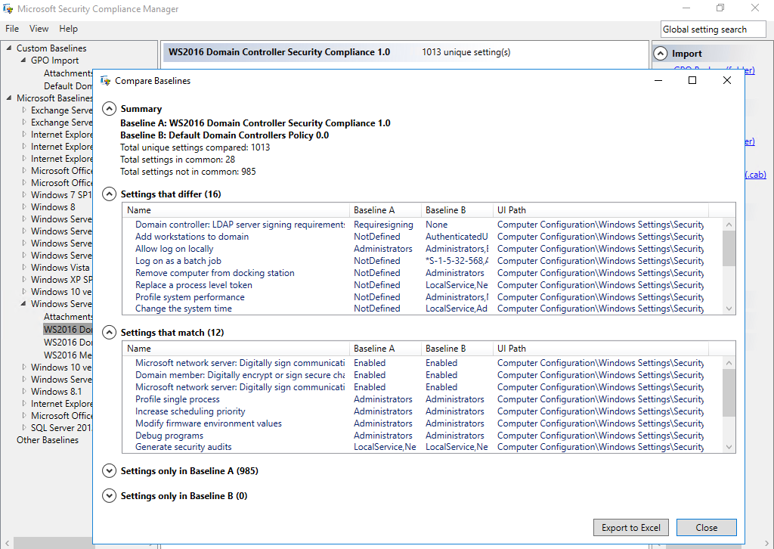
Endpoint Hardening
Operating System Security
  Workstations
  Servers
Baseline Configuration
  Interfaces
  Services
  Ports
  Storage
  Many others
Using Security Compliance Manager to compare settings in a production GPO with Microsoft's template policy settings. (Screenshot used with permission from Microsoft.)
Notes:
Note that Linux stores all configuration settings in text files. These can be scanned for baseline compliance (access.redhat.com/documentation/en-us/red_hat_enterprise_linux/7/html/security_guide/configuration-compliance-scanning_scanning-the-system-for-configuration-compliance-and-vulnerabilities).

Slide 4
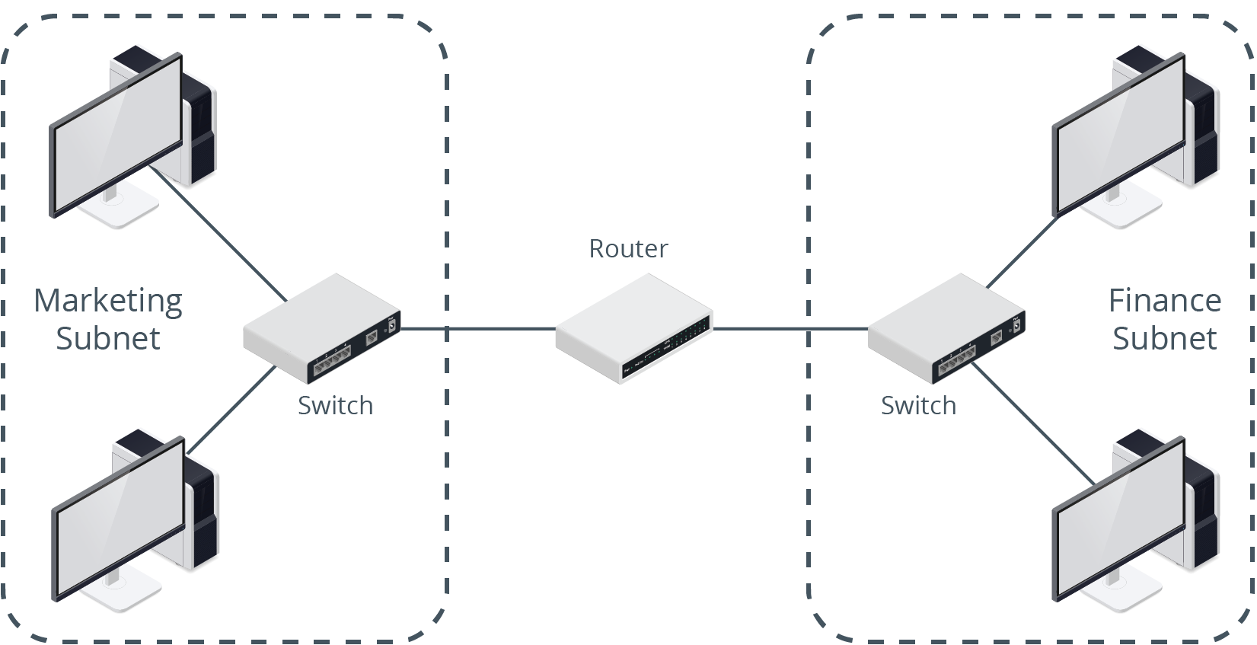
Endpoint Protection
Segmentation
Isolation
Antivirus and Antimalware
Disk Encryption
Patch Management
A segmented network showing Marketing and Finance subnets and the placement of network devices. Traffic between the two networks is controlled by the router. (Images © 123RF.com.)
Notes:
Students should hopefully be comfortable with the features and operation of AV scanners, so focus on advanced malware detection techniques.
Note that we'll cover DLP in more detail later in the course.

Slide 5
Advanced Endpoint Protection
Endpoint Detection and Response (EDR)
Extended Detection and Response (XDR)
Host-Based Intrusion Detection/Prevention (HIDS/HIPS)
User Behavior Analytics (UBA)/User and Entity Behavior Analytics (UEBA)
Notes:
Students should hopefully be comfortable with the features and operation of AV scanners, so focus on advanced malware detection techniques.
Note that we'll cover DLP in more detail later in the course.

Slide 6
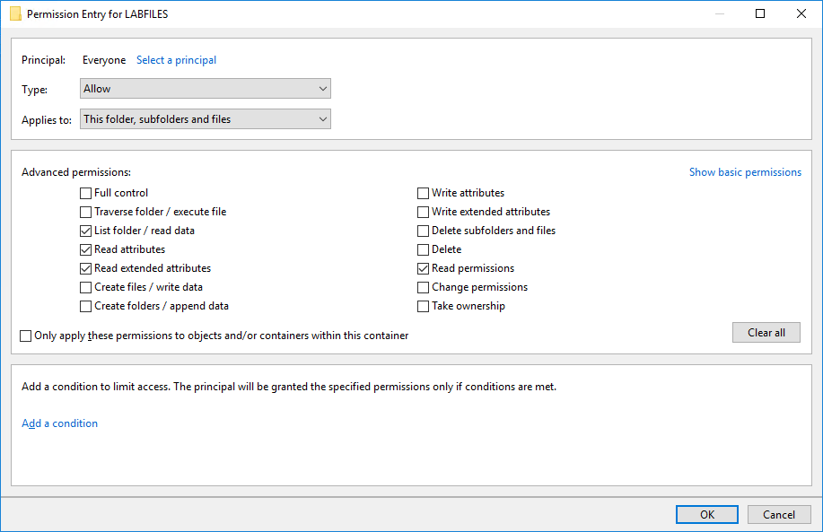
Endpoint Configuration
Principle of Least Privilege
Access Control Lists
File System Permissions
Application Allow Lists and Block Lists
Monitoring
Configuration Enforcement
Group Policy
SELinux
Configuring an access control entry for a folder. (Screenshot used with permission from Microsoft.)

Slide 7
Hardening Techniques
Protecting Physical Ports
Encryption
  Full Disk Encryption (FDE)
  Removable Media Encryption
  Virtual Private Networks (VPNs)
  Email Encryption
Host-Based Firewalls and IPS
Endpoint Protection
Changing Defaults
Removing Unnecessary Software
Notes:
Make sure students understand the risks from USB devices and how to identify indicators of attacks.

Slide 8
Hardening Specialized Devices
ICS/SCADA
  Strict network segmentation
  Robust authentication
  Unidirectional gateways (or data diodes)
    Limit data flow to one direction
Embedded and RTOS
  Select devices based on security capabilities
Notes:
Make sure students understand the risks from USB devices and how to identify indicators of attacks.

Slide 9
Endpoint Security
Endpoint Hardening
Endpoint Protection
Advanced Endpoint Protection
Endpoint Configuration
Hardening Techniques
Hardening Specialized Devices
Notes:
Take some time at the end of each topic to answer questions. You can use the review questions for discussion in class or set them for students to complete individually during or after class.

Slide 10
Assisted Lab: Using Group Policy
Applied Lab: Hardening

Slide 11
Mobile Device Hardening
Lesson 10
Topic 10B
Notes:
This is another topic where lab support is difficult. If you have a corporate MDM or EMM solution that you can show to the students as a demo, that would help. Otherwise, students should refer to vendor implementation guides.

Slide 12
Mobile Hardening Techniques
Many similarities between hardening mobile devices or traditional computers
Mobile devices are more prone to physical loss or theft
Deployment Models
  Bring your own device (BYOD
  Corporate owned, business only (COBO)
  Corporate owned, personally enabled (COPE)
  Choose your own device (CYOD)
Mobile Device Management
Full Device and External Media Encryption

Slide 13
Full Device Encryption and External Media
In iOS, there are various levels of encryption
  All user data on the device is always encrypted
  Email data and any apps using the “Data Protection” option are subject to a second round of encryption
In iOS, Data Protection encryption is enabled automatically when you configure a password lock on the device
A mobile device contains a solid state (flash memory) drive for persistent storage of apps and data
Notes:
Note that full disk encryption makes a handset less usable as a phone, so encryption is applied to user data areas rather than the whole device.

Slide 14
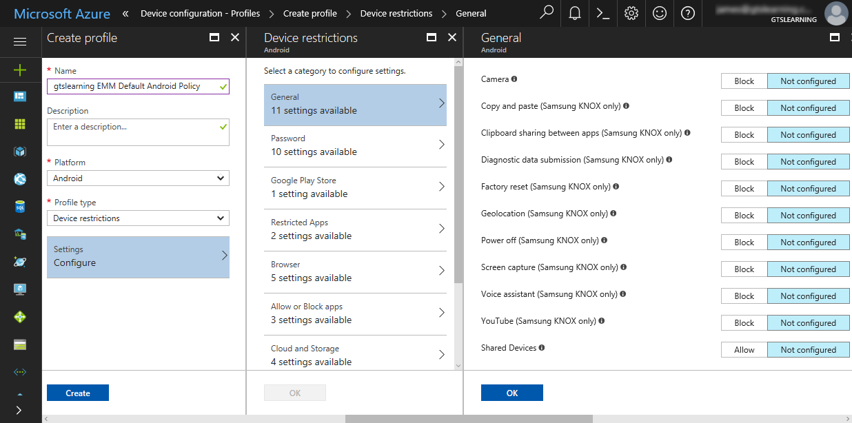
Location Services
Global Positioning System (GPS)
Indoor Positioning System (IPS)
Geofencing
GPS Tagging (ex. EXIF Data)
Primary concern of location services is privacy
Restricting device permissions such as camera and screen capture using Intune. (Screenshot used with permission from Microsoft.)
Notes:
Make sure students can distinguish the various geo-something technologies.

Slide 15
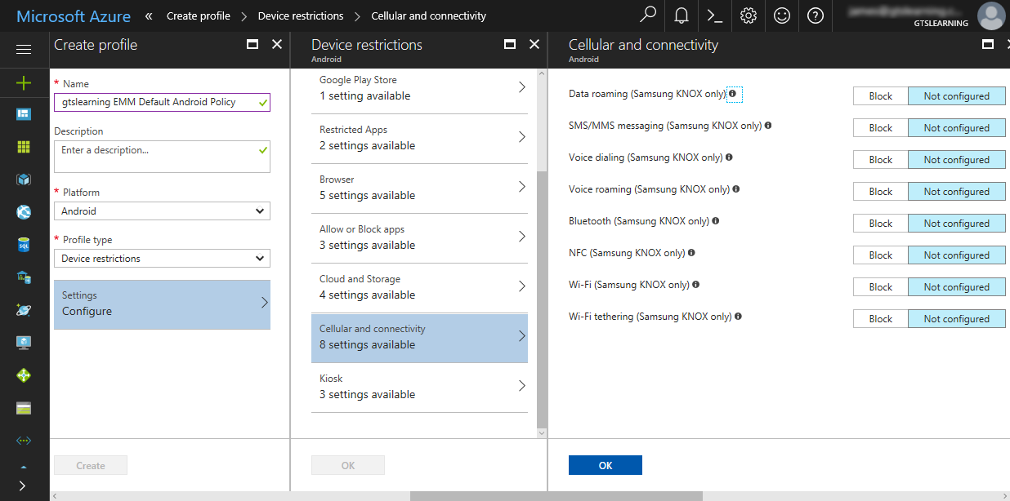
Cellular and GPS Connection Methods
Cellular/Mobile Data Connections
Global Positioning System (GPS)
Locking down Android connectivity methods with Intune—note that most settings can be applied only to Samsung KNOX-capable devices. (Screenshot used with permission from Microsoft.)

Slide 16
Wi-Fi and Tethering Connection Methods
Mobile devices usually default to using a Wi-Fi connection
  Home/Public vs Enterprise Network
  Rogue/Evil Twin networks
Personal Area Networks (PANs)
  Peripherals
  Other devices/computers
Ad Hoc Wi-Fi and Wi-Fi Direct
Tethering and Hotspots

Slide 17
Mobile Hardening Techniques
Full Device Encryption and External Media
Location Services
Cellular and GPS Connection Methods
Wi-Fi and Tethering Connection Methods
Bluetooth Connection Methods
Near-Field Communications and Mobile Payment Services
Notes:
Take some time at the end of each topic to answer questions. You can use the review questions for discussion in class or set them for students to complete individually during or after class.

Slide 18
Summary
CompTIA Security+ Exam SY0-701
Lesson 10

